Slide 1
Usability Test
VRL School Resource Manager (Version 8)
Byron Buckley
Research methods for interaction design| IDIA-642

Slide 2
Purpose, goals, and objectives of the test
School Resource Manager (Version 8) is web application developed and maintained by VRL Software. It has been deployed for use at a number of Jamaican schools.

Slide 3
Purpose, goals, and objectives of the test
The goals of this study are to:
Assess the effectiveness of the application for performing tasks such as entering grades, viewing reports, etc.
Identify obstacles teachers experienced during common tasks and determine if there is any correlation to their computer and web use.

Slide 4
Purpose, goals, and objectives of the test
Goals cont’d:
Identify if a teacher could complete their tasks successfully with little or no exposure to application help documentation.
Determine if the interface satisfactorily meet Nielsen’s ten usability heuristics for user interface design?

Slide 5
Location and Setup
The teachers are allowed to access the application outside of the premises, however for the purposes of the study, tests will take place in a controlled setting at the Queens High School, Kingston, St. Andrew. Participants will use a Windows PC, with Internet Explorer, the browser required for using the application. The PC that the participant uses will also have Morae recorder installed on it and a web camera attached. The web camera will capture the participant’s face; the Morae software will record what’s happening on the screen (and can collect other data).

Slide 6
Method (test design)
Task lists and scenarios were derived from a help document provided by one of the teachers prior to testing.
Qualitative data about the participants’ experiences using the application were collected via surveys and think thinking aloud as they work.
Sessions typically lasted 30 minutes. A few minutes were utilized at the beginning to explain the session to the participant as well as review basic background information with the participant. Each participant performed a pre-test survey, their assigned tasks and then a post-test survey.

Slide 7
Changes and minutiae
The participant in pilot test revealed that the tests could not be performed on live data, as only the administrator can remove certain entries. Upon request the administrator provided two classes that we could perform the tests on.
Pilot test revealed that some of the tasks I listed could only be performed by form teachers (teachers with a homeroom) as only they have those responsibilities, for example: marking the register. This also caused me to reorder my questions, grouping them by role, for easier use by participant.

Slide 8
Changes and minutiae
The pre-test survey was added prior to the pilot test.
For P2, I had to write down her comments and do an audio recording with my phone. P2 had many comments triggered by the posttest survey, this prompted me to adjust the survey to include “free text” fields for various questions, so that the teacher can elaborate on the question score when necessary.
Task definitions were added to the Morae Recorder study configuration during the video reviews instead of prior to the tests.

Slide 9
Participant characteristics
Participants were selected from the teaching staff of the Queens High School. According to the criteria below:
Participant Type | Description | Planned # of Participants | Actual # of Participants
Novice/Beginner | New teacher at school or teacher who has never used the application. | 2 | 2
Intermediate | Intermediate users are those who meet neither novice or expert | 2 | 0
Expert | Expert users’ names will be provided by the application administrator at the school. | 2 | 2

Slide 10
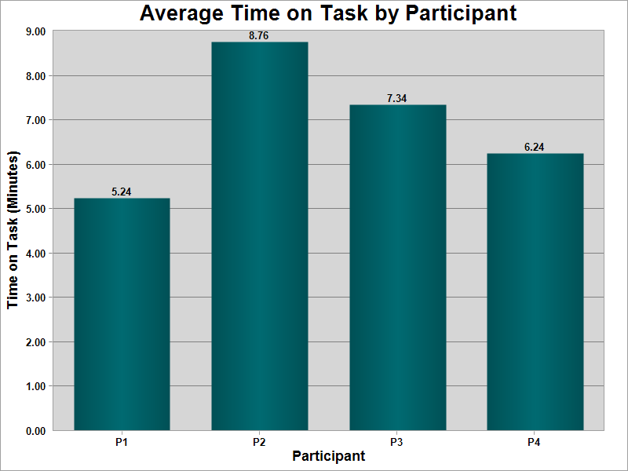
Results
Graph based on tasks defined below:
Students have just completed their mid-semester exams, and you are required to record their grades.
Please enter grades for a class that you teach multiple streams.
Based on the class selected in task 6a, please enter grades for another stream.
From this screen, please select another class who has completed mid-semester exams and enter the grades.
The semester has come to a close and parents must receive their children’s report. Please create the reports for the classes you are responsible for.
N.B. P1 actually failed task 1.

Slide 11
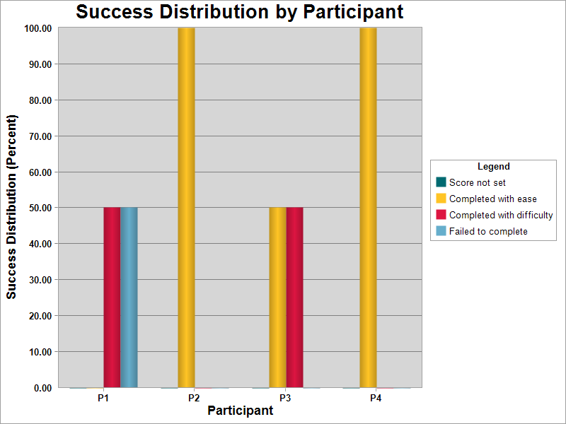
Results
Graph based on tasks defined below:
Students have just completed their mid-semester exams, and you are required to record their grades.
Please enter grades for a class that you teach multiple streams.
Based on the class selected in task 1a, please enter grades for another stream.
From this screen, please select another class who has completed mid-semester exams and enter the grades.
The semester has come to a close and parents must receive their children’s report. Please create the reports for the classes you are responsible for.
N.B. The expert users were the ones that completed their tasks with ease.

Slide 12
Notable Survey Feedback
Question | Answer
I found the system unnecessarily complex. Please elaborate in the section below. | It takes too long and the font is too small. Clear in some areas complex in others. Documentation could be better If I set a student as absent, the option to set them as late should be cleared and disabled.
I found the various functions in this system were well integrated. Please elaborate in the section below. | Yes, this is so because you can put in your grades and make a comment at the same time.
I found the system very cumbersome to use. Please elaborate in the section below. | Not really, you had different options for specific task and all you had to do was to enter the relevant fields.

Slide 13
General Findings
I approached the application with the assumptions:
ugly application = poor usability
ugly application = low/poor user buy in
ugly application = users hate the application
¾ of the test body was able to complete all he tests successfully. With one user describing the application as “very usable” (expert user). Stronger participants typically had been using the application for a long time, and had become accustomed to using it. Actual usability issues were in fact low, and users seemed generally appreciative of the tool. User concerns were more targeted towards application uptime, with one user mentioning that it’s called “the crock” by some teachers.

Slide 14
General Findings
Out of the box task success is not a strength of the application, i.e. documentation use at least at the beginning, is crucial to using the application successfully. Despite navigation labeling that is generally consistent with that of a school, one teacher was unsuccessful in her task due to little exposure to help and documentation in using the app.
Log out links were absent, and labels stating the current user were absent from most pages.
Ultimately my view assumption that the application was not usable, was proven wrong.

Slide 15
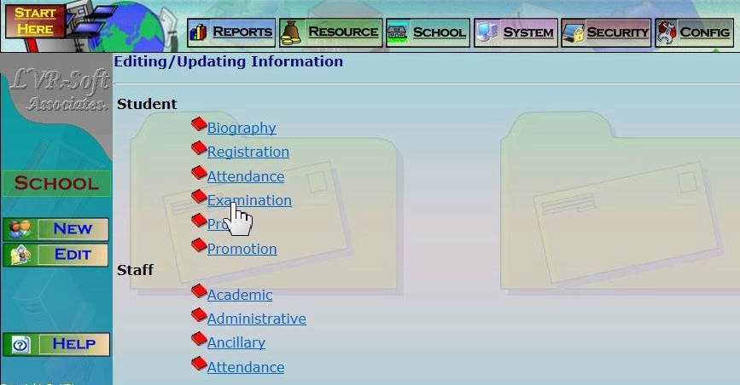
Specific Findings and Recommendations
Navigation and labeling is largely adherent to terms associated with teaching and administration at a school.

Slide 16
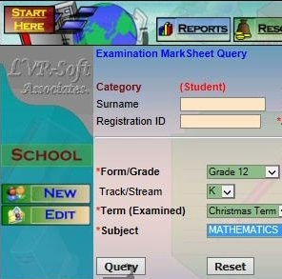
Specific Findings and Recommendations
Use of Technical Terms:
The word “query” should have been omitted from the page label.
The “query” label could have been labelled something less technical like “Show List”, “View List”, “View Student List”.
1
2

Slide 17
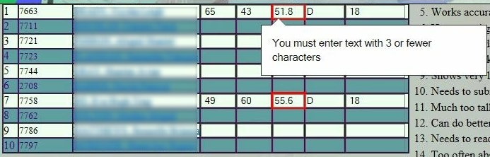
Specific Findings and Recommendations
Error Handling:
The error on the right is actually occurring on a field that is auto populated by the application. The application is effectively creating an error for itself that prevents the teacher from entering the correct grade for the student.

Slide 18
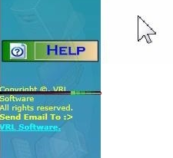
Specific Findings and Recommendations
Status:
A animated green bar running to the left and right was mistaken to be a status indicator. It is easy to understand why the user was mistaken, the animation is much like today’s “AJAX Style” loading indicators. This mistake indicates that:
Users expect a status indicator
Users expect almost everything in their application to be useful or provide feedback.
Never use commonly accepted imagery in an unexpected way.
P2 thought the animation to the left was a status indicator.

Slide 19
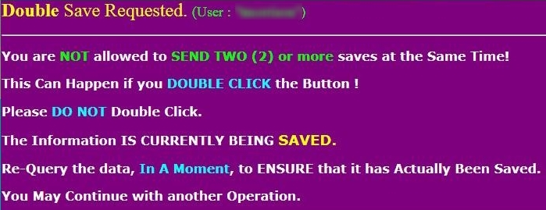
Specific Findings and Recommendations
What’s a double save?!?!
This error can be prevented by the developers. I do not believe a user should be seeing this message for accidentally double-clicking a button.

Slide 20
Application’s adherence to usability heuristics
Heuristic | Findings
Visibility of system status | The web application does not provide any status of the application state. While the web browser running the application typically shows page activity, the application it self displays nothing to indicate statuses like: loading, waiting, busy, connected, disconnected etc. In fact the navigation bar on the left, contains an animation similar to those used to indicate loading/waiting/busy status.
Match between system and the real world | Main navigation labels match school administration terms for the most part.
User control and freedom | The application does not consistently provide “emergency exit” options via a cancel button, users however have the option to use the browser’s back button to navigate to the previous screen, which allows for partial undo/redo functionality.

Slide 21
Application’s adherence to usability heuristics
Heuristic | Findings
Consistency and standards | Conventions within the application typically remain consistent.
Error prevention | Field validation is inconsistent throughout the app. On the grades form, field validation is being applied to a field that is automatically populated by the system and prevents the user from continuing their task the right way. Application does not utilize confirmation messages for actions across the application.
Recognition rather than recall | Contextual help is not available.
Flexibility and efficiency of use | User mentioned that there are sections of the application where they must enter content they had already entered at another part of the application. User mentioned that she has to manually remove extracurricular activities from students each school year. She feels this student info should be reset at the end of each semester.

Slide 22
Application’s adherence to usability heuristics
Heuristic | Findings
Aesthetic and minimalist design | The UI is largely utilitarian. Apart from logo placements, the UI is devoted to the current task.
Help users recognize, diagnose, and recover from errors | Error messages are clear.
Help and documentation | System provides help documentation.

Slide 23
APPENDIX

Slide 24
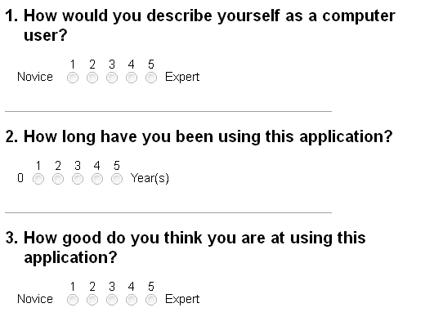
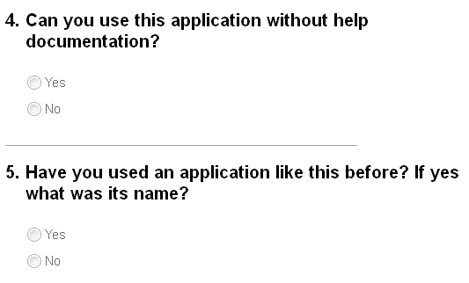
Pre-test Survey

Slide 25
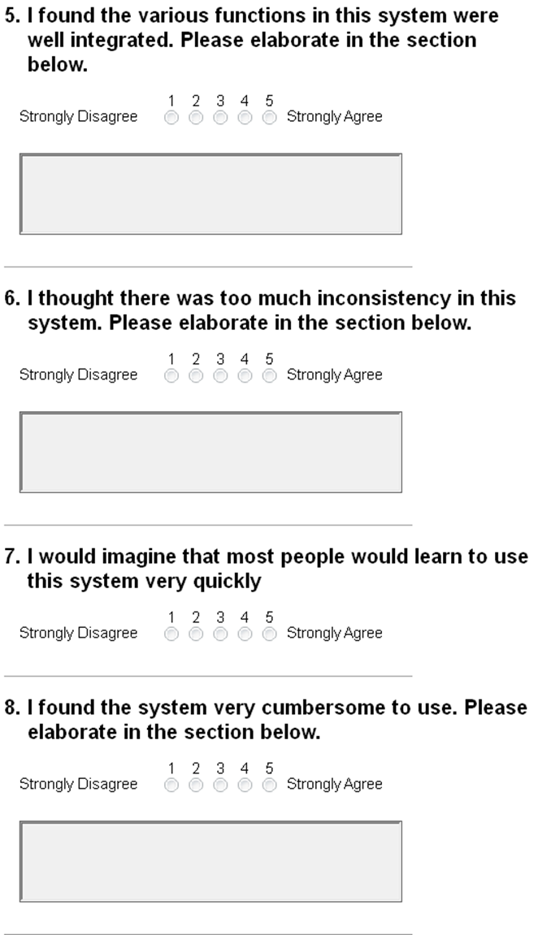
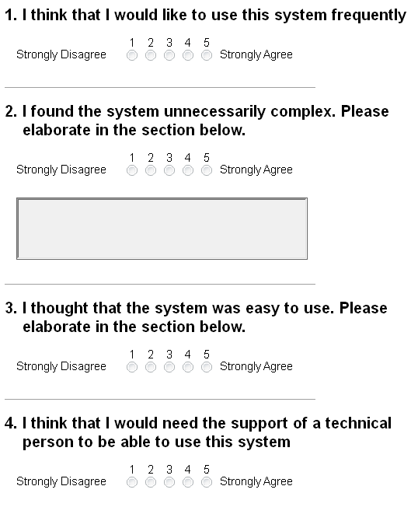
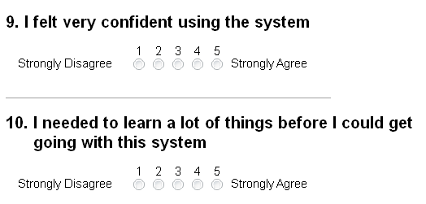
Post-test Survey

Slide 26
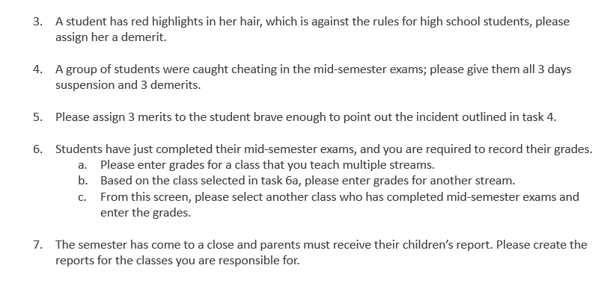
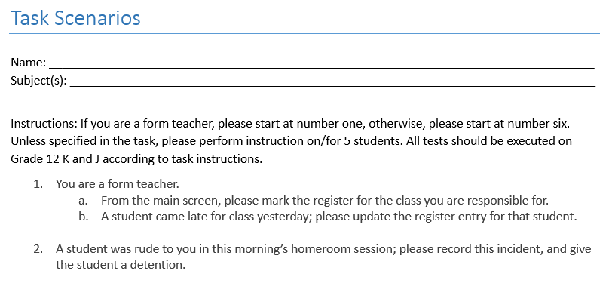
Task Scenarios
Notes:
Example of the Task Scenarios

Slide 27
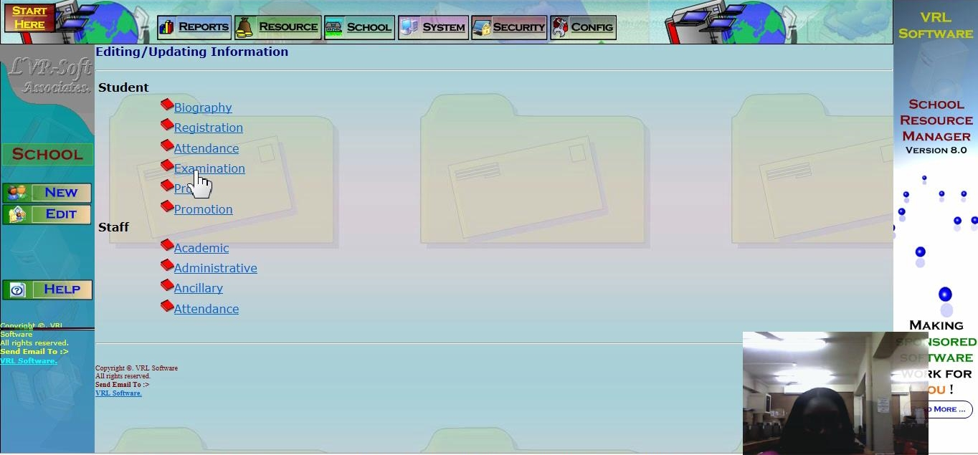
Participant 1 Doing Task 6

Slide 28
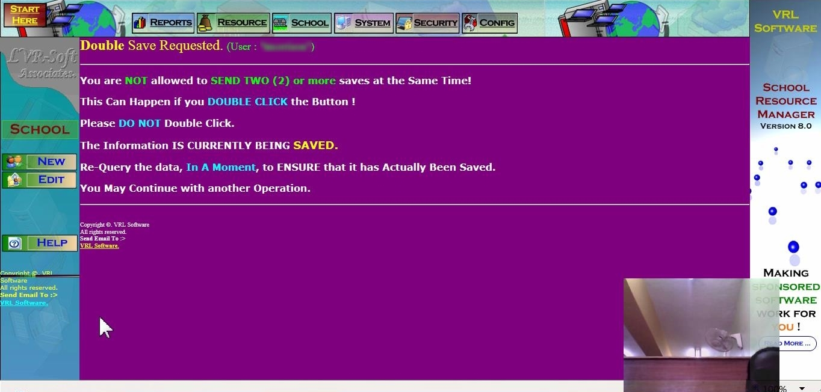
Participant 2 Experiencing a Double Save Error
Please elaborate in the section below.

Slide 29
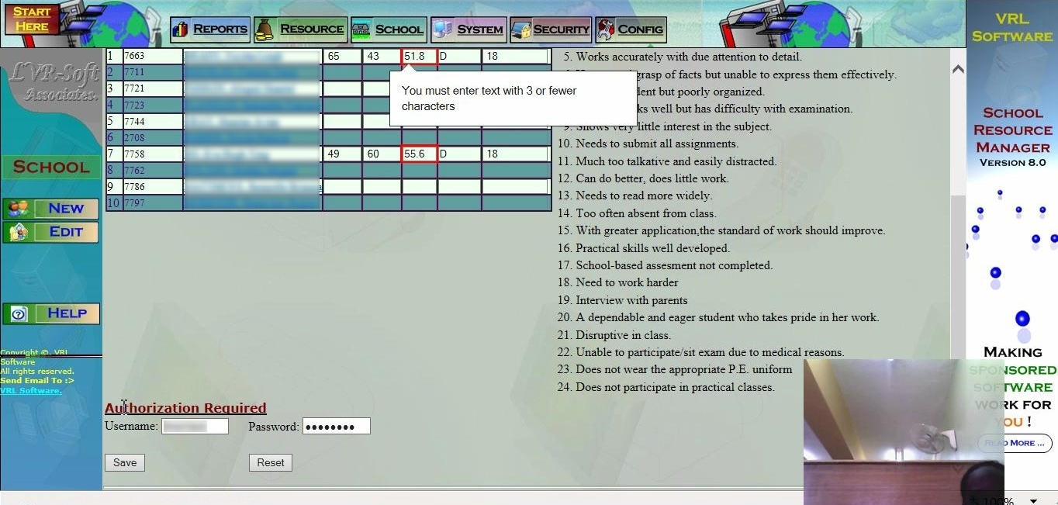
Participant 2 Experiencing a Field Validation Error during Task 6.
P2. indicates that she cannot save the grades she has entered because of a field validation error message tied to the automatically generated student column. The error was "You must enter text with 3 or fewer characters". This was resolved by changing the individual grade until a round value was generated in the field.
P4. commented on the field validation issues experienced by users. She informed me that this doesn't happen in all browsers and that she basically inputs the correct grades in one browser and then returns to her preferred browser for the other tasks.

Slide 30
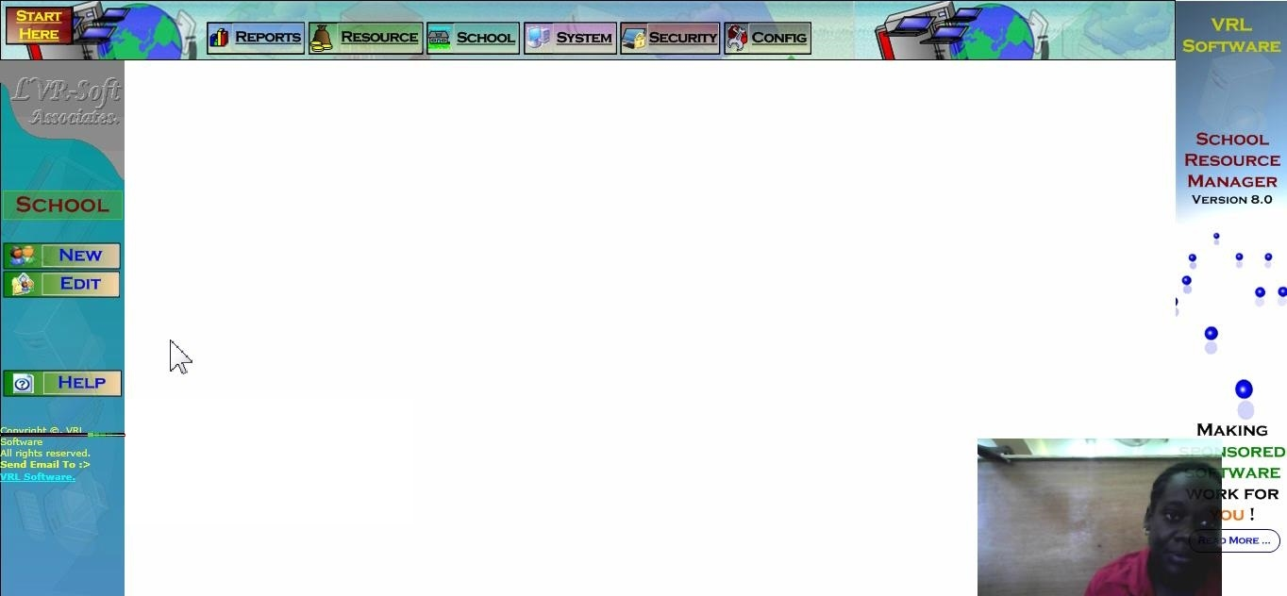
An Observation with Participant 2.
We lost connection to the application server due to poor Wi-Fi connectivity. The teacher is unaware of this and thinks the animated GIF at the bottom left of the screen is a loading/status indicator. I point out to her that it actually means nothing. We resume the tests after I tether my phone to the computer to share its internet connection.
P2 thought the animation to the left was a status indicator.

Slide 31
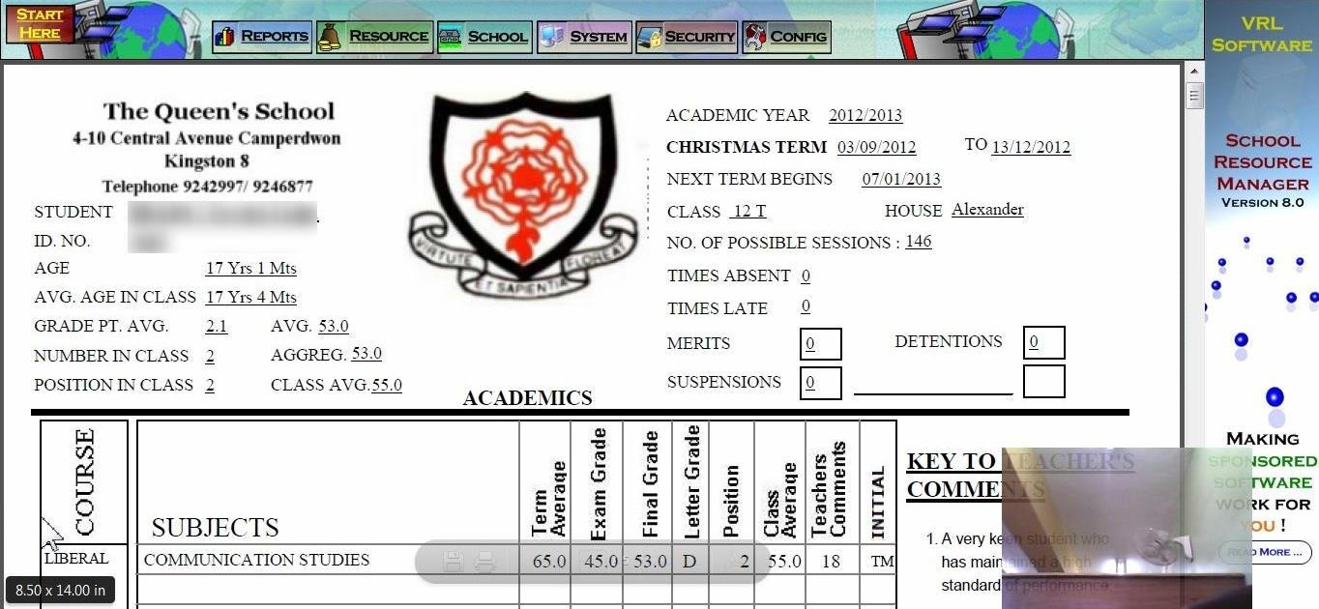
Task 7: Report Generated
P4 shared that some the browsers do not generate the report.

Slide 32
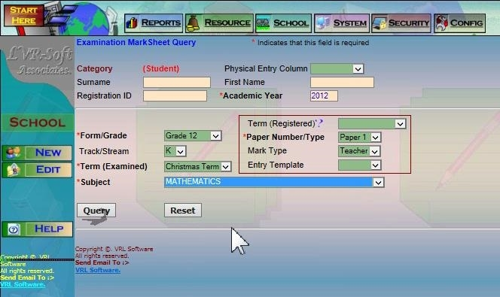
UI to Select Class to Enter Grades

Slide 33
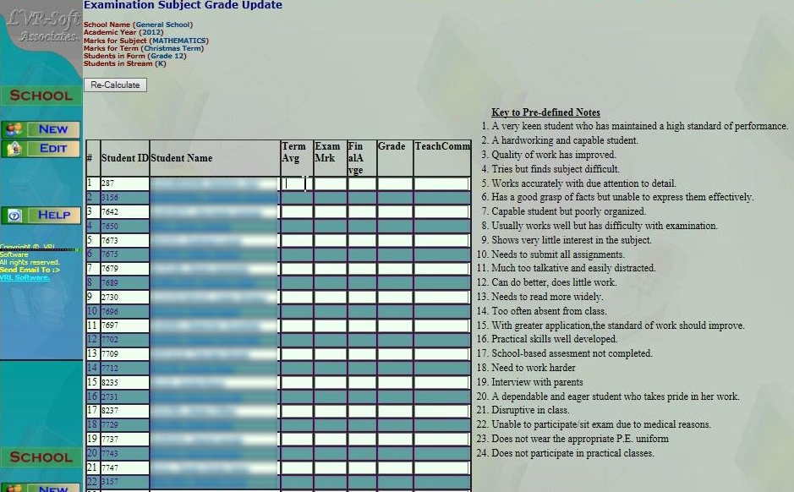
UI for Entering Grades

Slide 34
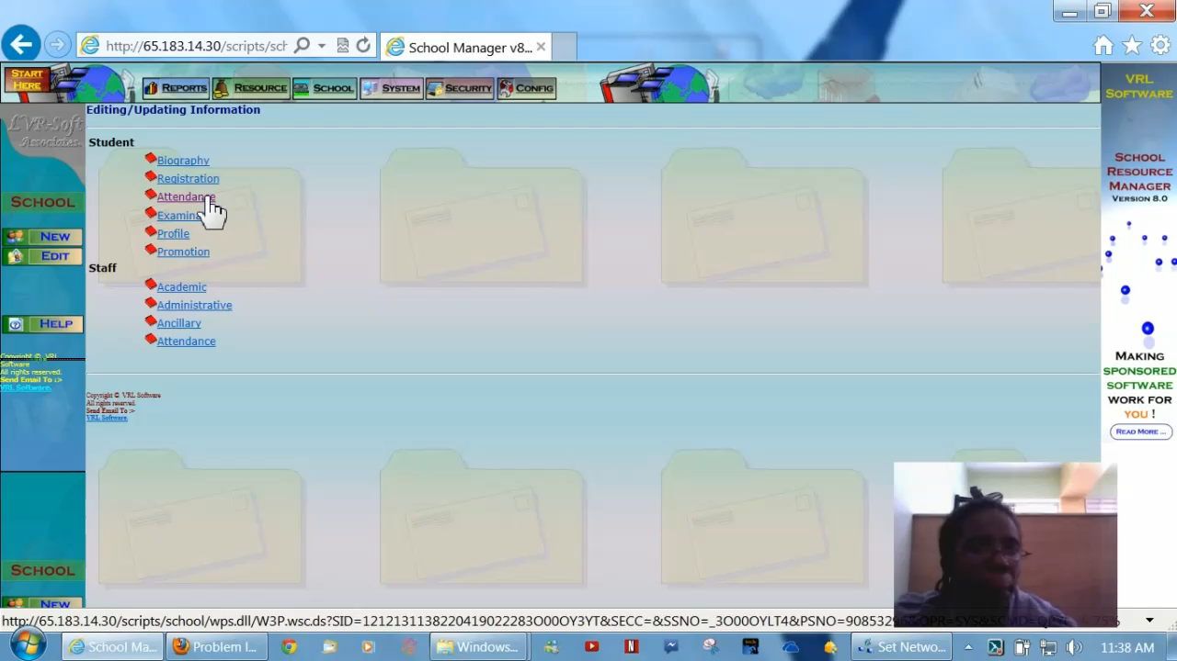
Video: P4, Task 1
You are a form teacher.
From the main screen, please mark the register for the class you are responsible for.
A student came late for class yesterday; please update the register entry for that student.
N.B. Audio muted due to background noise.
Notes:
Audio muted due to background noise.

Slide 35
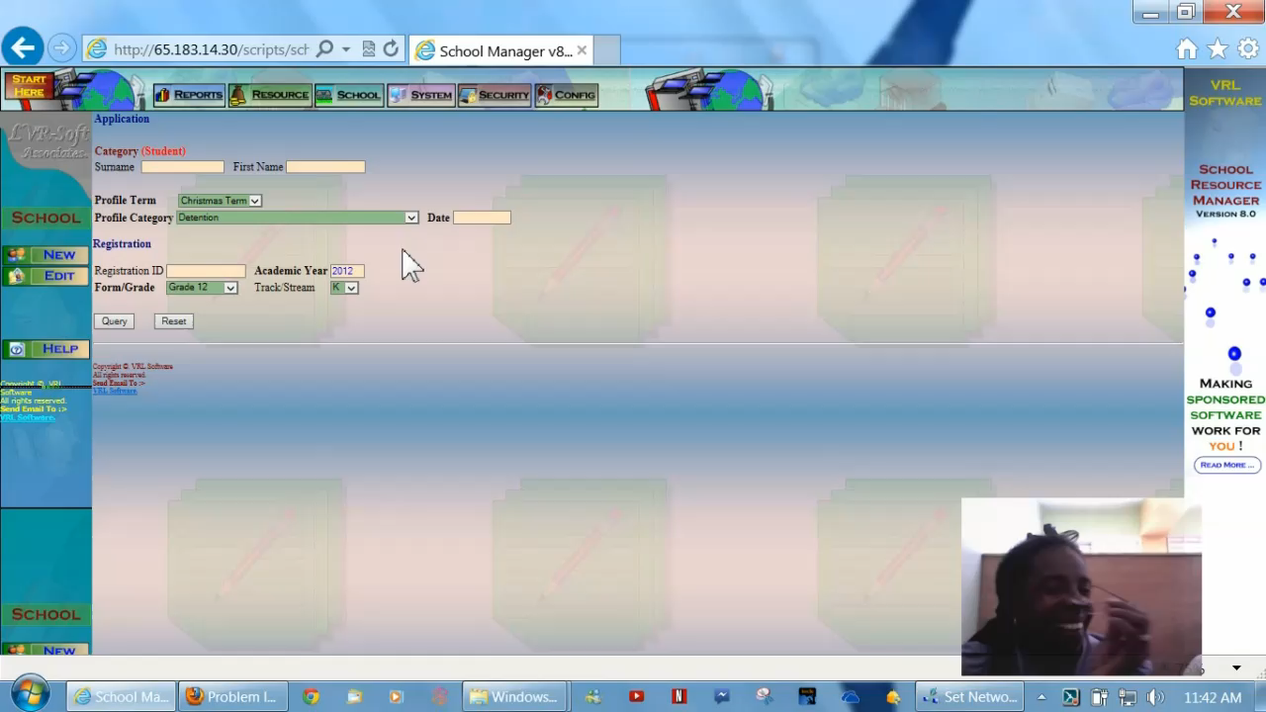
Video: P4, Task 2
A student was rude to you in this morning’s homeroom session; please record this incident, and give the student a detention.
There seemed to be no straightforward way to do this. P4 explained there is some kind of bug whereby these detentions are not being displayed.
N.B. Audio muted due to background noise.
Notes:
Audio muted due to background noise.

Slide 36
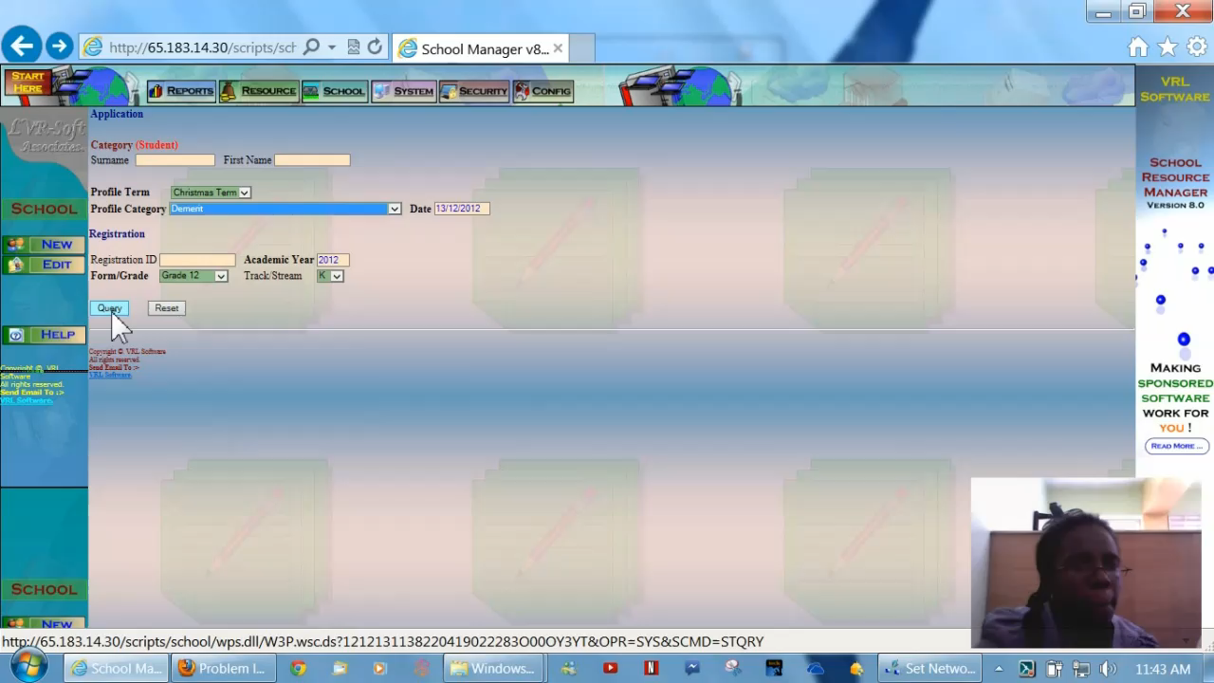
Video: P4, Task 3
A student has red highlights in her hair, which is against the rules for high school students, please assign her a demerit.
N.B. Audio muted due to background noise.
Notes:
Audio muted due to background noise.

Slide 37
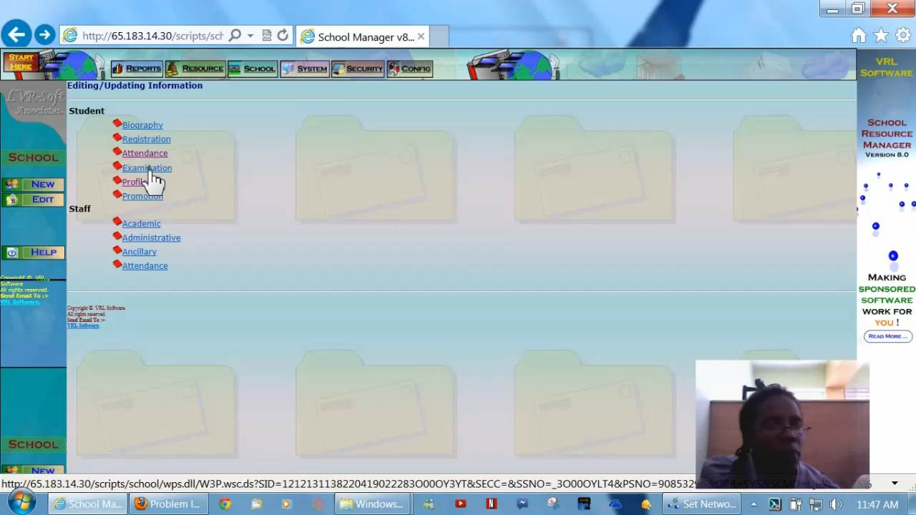
Video: P4, Task 6a
Students have just completed their mid-semester exams, and you are required to record their grades.
Please enter grades for a class that you teach multiple streams.
N.B. Audio muted due to background noise.
Notes:
Audio muted due to background noise.

